Slide 1

Bitcoin

Slide 2
Bitcoin (₿) is a decentralized digital currency, without a central bank or single administrator, that can be sent from user to user on the peer-to-peer bitcoin network without the need for intermediaries. Transactions are verified by network nodes through cryptography and recorded in a public distributed ledger called a blockchain. The cryptocurrency was invented in 2008 by an unknown person or group of people using the name Satoshi Nakamoto. The currency began use in 2009 when its implementation was released as open-source software.
Bitcoins are created as a reward for a process known as mining. They can be exchanged for other currencies, products, and services. Bitcoin has been criticized for its use in illegal transactions, the large amount of electricity (and thus carbon footprint) used by mining, price volatility, and thefts from exchanges. Some investors and economists have characterized it as a speculative bubble at various times. Others have used it as an investment, although several regulatory agencies have issued investor alerts about bitcoin. In September 2021, El Salvador officially adopted Bitcoin as legal tender, becoming the first nation to do so.
The word bitcoin was defined in a white paper published on 31 October 2008. It is a compound of the words bit and coin. No uniform convention for bitcoin capitalization exists; some sources use Bitcoin, capitalized, to refer to the technology and network and bitcoin, lowercase, for the unit of account. The Wall Street Journal, The Chronicle of Higher Education, and the Oxford English Dictionary advocate the use of lowercase bitcoin in all cases.

Slide 3
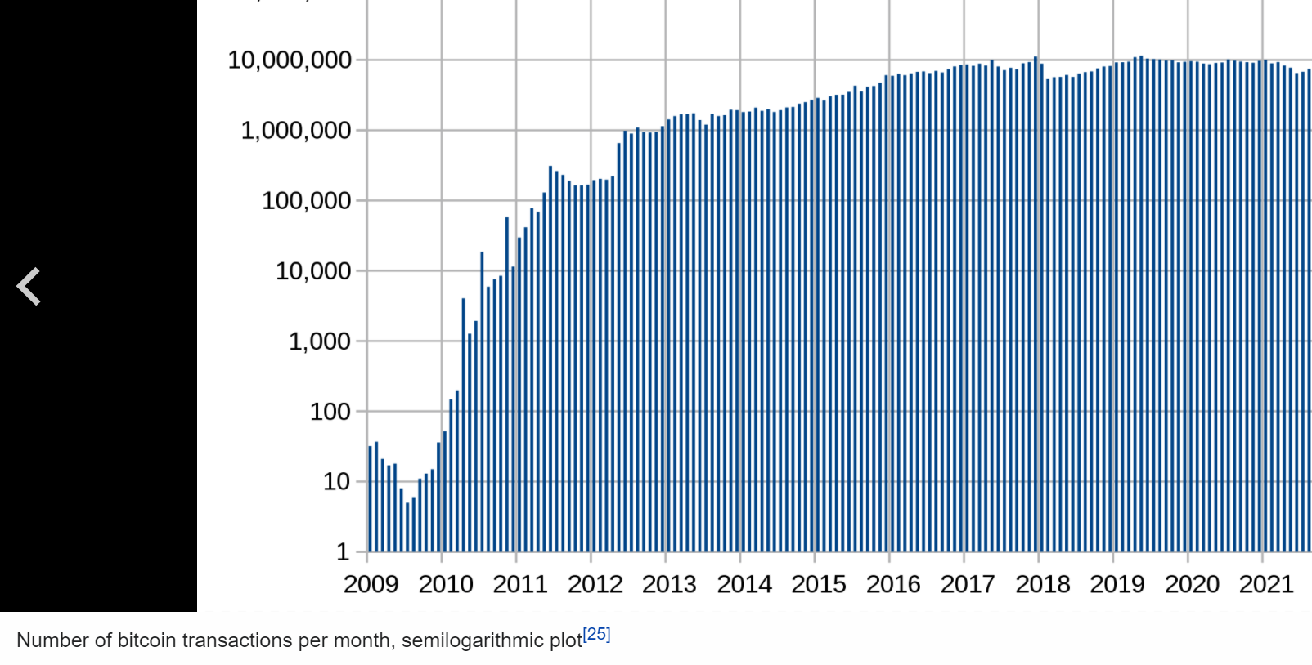
Blockchain

Slide 4
The bitcoin blockchain is a public ledger that records bitcoin transactions. It is implemented as a chain of blocks, each block containing a hash of the previous block up to the genesis block in the chain. A network of communicating nodes running bitcoin software maintains the blockchain. Transactions of the form payer X sends Y bitcoins to payee Z are broadcast to this network using readily available software applications.
Network nodes can validate transactions, add them to their copy of the ledger, and then broadcast these ledger additions to other nodes. To achieve independent verification of the chain of ownership each network node stores its own copy of the blockchain. At varying intervals of time averaging to every 10 minutes, a new group of accepted transactions, called a block, is created, added to the blockchain, and quickly published to all nodes, without requiring central oversight. This allows bitcoin software to determine when a particular bitcoin was spent, which is needed to prevent double-spending. A conventional ledger records the transfers of actual bills or promissory notes that exist apart from it, but the blockchain is the only place that bitcoins can be said to exist in the form of unspent outputs of transactions.
Individual blocks, public addresses and transactions within blocks can be examined using a blockchain explorer.

Slide 5
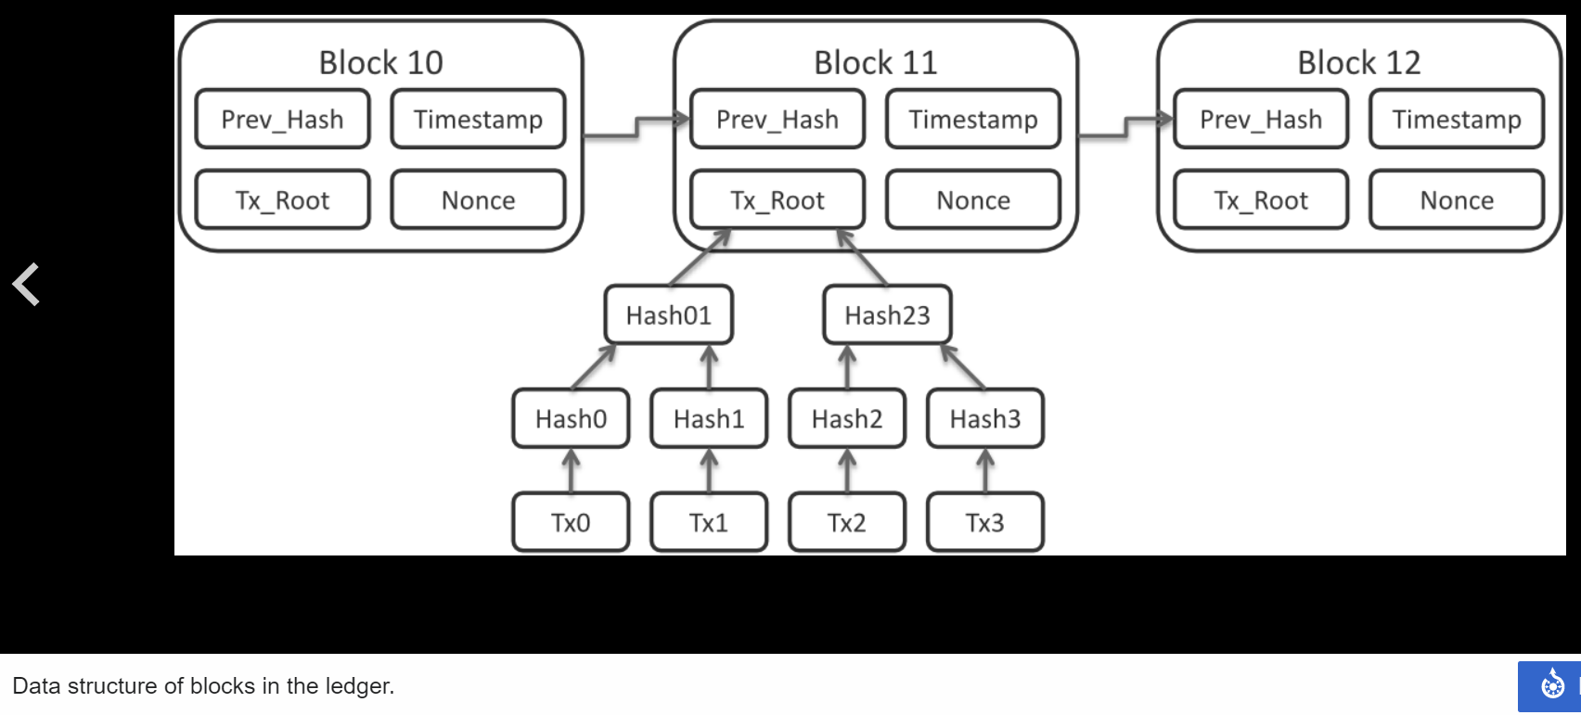

Slide 6
Transactions
Transactions are defined using a Forth-like scripting language. Transactions consist of one or more inputs and one or more outputs. When a user sends bitcoins, the user designates each address and the amount of bitcoin being sent to that address in an output. To prevent double spending, each input must refer to a previous unspent output in the blockchain. The use of multiple inputs corresponds to the use of multiple coins in a cash transaction. Since transactions can have multiple outputs, users can send bitcoins to multiple recipients in one transaction. As in a cash transaction, the sum of inputs (coins used to pay) can exceed the intended sum of payments. In such a case, an additional output is used, returning the change back to the payer. Any input satoshis not accounted for in the transaction outputs become the transaction fee.
Though transaction fees are optional, miners can choose which transactions to process and prioritize those that pay higher fees. Miners may choose transactions based on the fee paid relative to their storage size, not the absolute amount of money paid as a fee. These fees are generally measured in satoshis per byte (sat/b). The size of transactions is dependent on the number of inputs used to create the transaction, and the number of outputs.
The blocks in the blockchain were originally limited to 32 megabytes in size. The block size limit of one megabyte was introduced by Satoshi Nakamoto in 2010. Eventually the block size limit of one megabyte created problems for transaction processing, such as increasing transaction fees and delayed processing of transactions. Andreas Antonopoulos has stated Lightning Network is a potential scaling solution and referred to lightning as a second layer routing network.

Slide 7
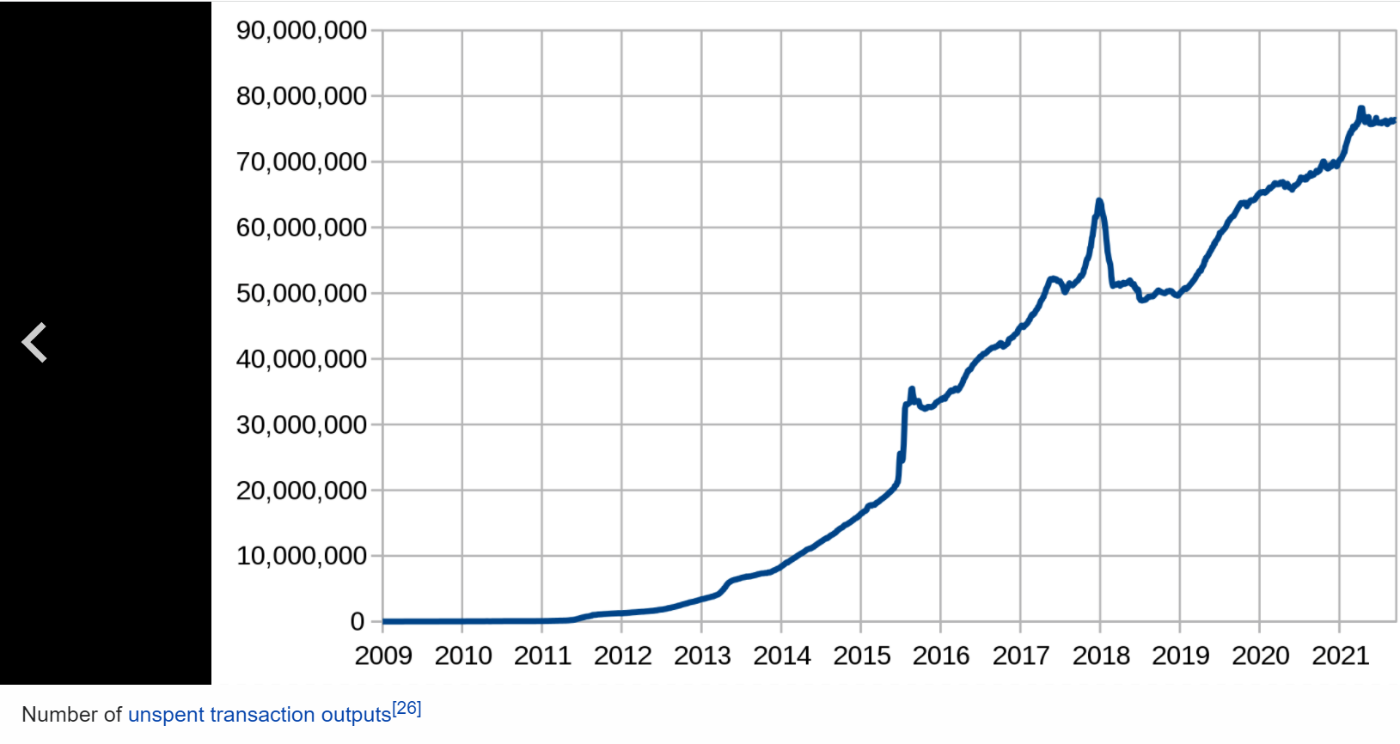

Slide 8
Ownership
In the blockchain, bitcoins are registered to bitcoin addresses. Creating a bitcoin address requires nothing more than picking a random valid private key and computing the corresponding bitcoin address. This computation can be done in a split second. But the reverse, computing the private key of a given bitcoin address, is practically unfeasible. Users can tell others or make public a bitcoin address without compromising its corresponding private key. Moreover, the number of valid private keys is so vast that it is extremely unlikely someone will compute a key-pair that is already in use and has funds. The vast number of valid private keys makes it unfeasible that brute force could be used to compromise a private key. To be able to spend their bitcoins, the owner must know the corresponding private key and digitally sign the transaction. The network verifies the signature using the public key; the private key is never revealed.
If the private key is lost, the bitcoin network will not recognize any other evidence of ownership; the coins are then unusable, and effectively lost. For example, in 2013 one user claimed to have lost 7,500 bitcoins, worth $7.5 million at the time, when he accidentally discarded a hard drive containing his private key. About 20% of all bitcoins are believed to be lost -they would have had a market value of about $20 billion at July 2018 prices.
To ensure the security of bitcoins, the private key must be kept secret. If the private key is revealed to a third party, e.g. through a data breach, the third party can use it to steal any associated bitcoins. As of December 2017, around 980,000 bitcoins have been stolen from cryptocurrency exchanges.
Regarding ownership distribution, as of 16 March 2018, 0.5% of bitcoin wallets own 87% of all bitcoins ever mined.

Slide 9
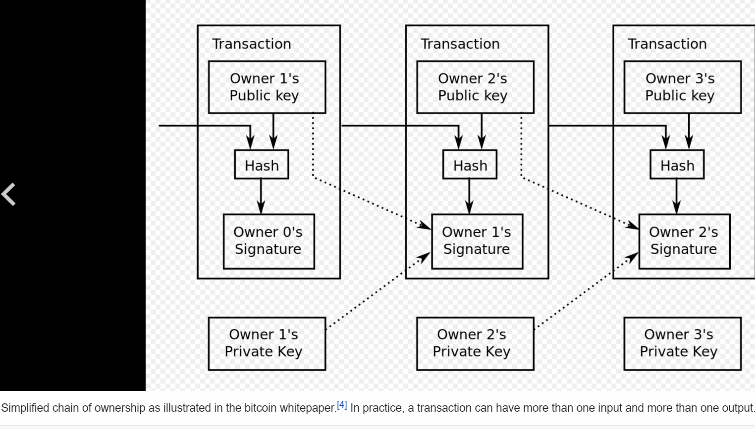

Slide 10
Mining
Mining is a record-keeping service done through the use of computer processing power. Miners keep the blockchain consistent, complete, and unalterable by repeatedly grouping newly broadcast transactions into a block, which is then broadcast to the network and verified by recipient nodes. Each block contains a SHA-256 cryptographic hash of the previous block, thus linking it to the previous block and giving the blockchain its name.
To be accepted by the rest of the network, a new block must contain a proof-of-work (PoW). The PoW requires miners to find a number called a nonce (number used once), such that when the block content is hashed along with the nonce, the result is numerically smaller than the network's difficulty target. This proof is easy for any node in the network to verify, but extremely time-consuming to generate, as for a secure cryptographic hash, miners must try many different nonce values (usually the sequence of tested values is the ascending natural numbers: 0, 1, 2, 3, ...) before a result happens to be less than the difficulty target. Because the difficulty target is extremely small compared to a typical SHA-256 hash, block hashes have many leading zeros

Slide 11
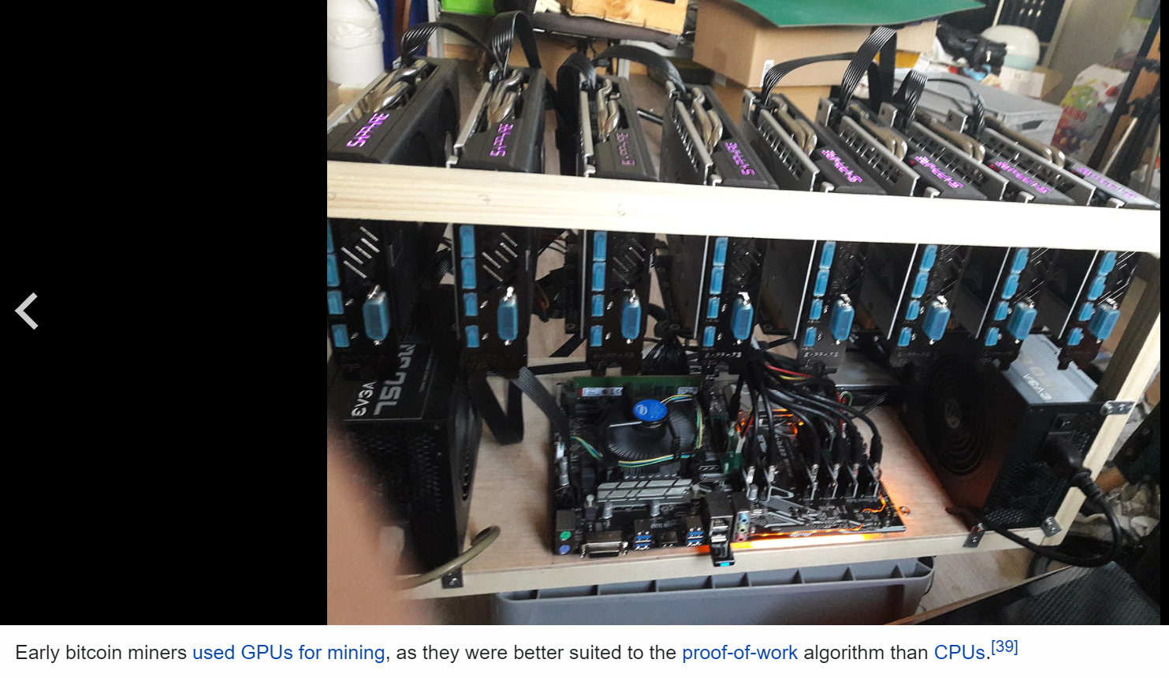

Slide 12
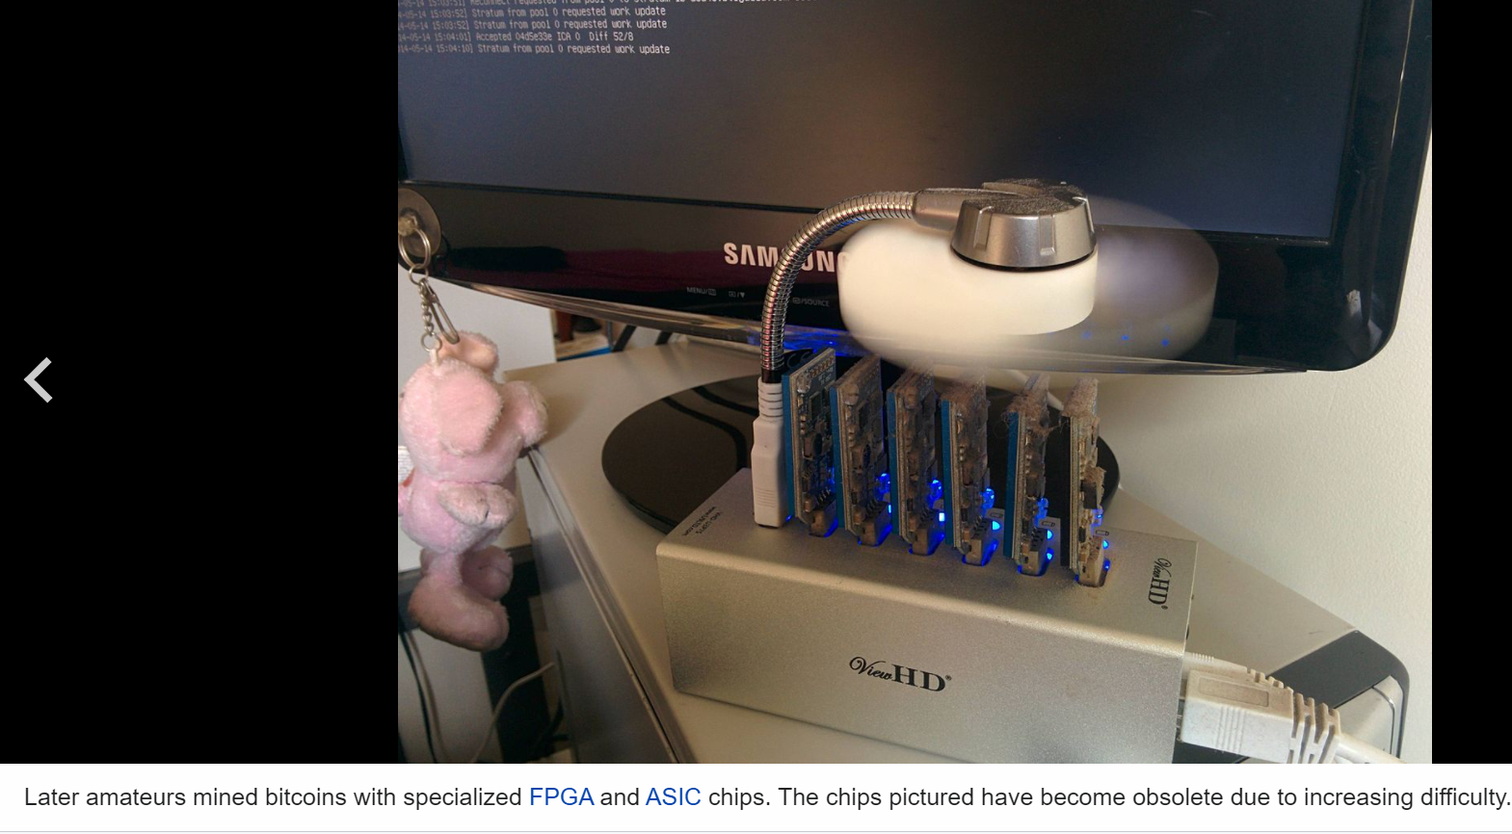

Slide 13
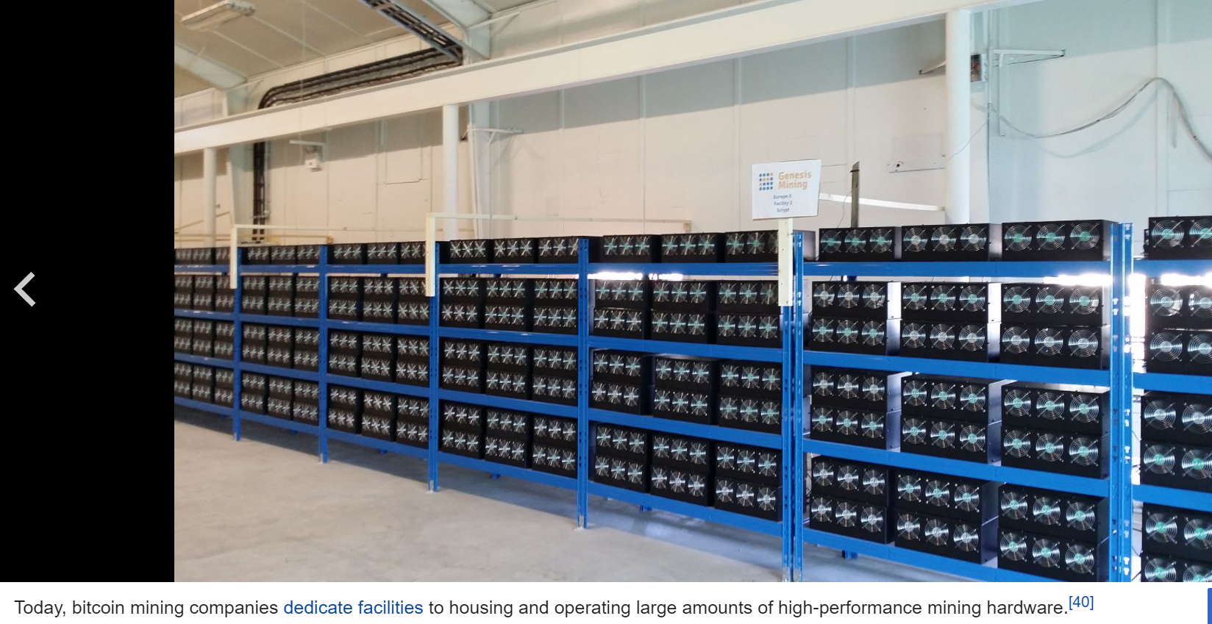

Slide 14
Is Bitcoin mining illegal?
The legality of Bitcoin mining depends entirely on your geographic location. The concept of Bitcoin can threaten the dominance of fiat currencies and government control over the financial markets. For this reason, Bitcoin is completely illegal in certain places.

Slide 15
How long does it take to mine 1 Bitcoin?
With today's difficulty rate, it may take a solo miner nearly five years to mine just one bitcoin. That's the average rate for miners, even for those who use the most efficient mining hardware. Oct 22, 2021

Slide 16
How much do Bitcoin miners make?
If a miner is able to successfully add a block to the blockchain, they will receive 6.25 bitcoins as a reward. The reward amount is cut in half roughly every four years, or every 210,000 blocks. As of November 2021, bitcoin traded at around $66,000, making 6.25 bitcoins worth more than $400,000. Nov 8, 2021

